Slide 1
Gov 1780: International Political Economy
Section 11
8 Apr 2021

Slide 2
Agenda
Housekeeping
Midterm debrief
Heads up on Essay #2
No section next week due to “Wellness day”
International finance & MNCs
Review key terms and readings
Activity: solve some real world puzzles!

Slide 3
Housekeeping
Midterm debrief
We will aim to return grades + feedback next week
Remember, the final exam will have the same format, so it is worth spending some time reviewing your feedback
Essay #2
The prompts for essay #2 will be released Monday 12th and due Monday 19th April

Slide 4
OK! Let’s review some key terms and concepts from the topic of International Finance and Multinational Corporations...

Slide 5
Key terms
What are the two types of foreign investment?
Portfolio investment (think: stocks/bonds)
Foreign Direct Investment (think: foreign company buys a domestic one)
What are “greenfield” and “brownfield” investments?
Greenfield: parent firm creates a new subsidiary in another country
Brownfield: parent firm buys an existing firm in another country

Slide 6
Key terms
What are the two types of foreign investment?
Portfolio investment (think: stocks/bonds)
Foreign Direct Investment (think: foreign company buys a domestic one)
What are “greenfield” and “brownfield” investments?
Greenfield: parent firm creates a new subsidiary in another country
Brownfield: parent firm buys an existing firm in another country

Slide 7
Key terms
What are the two types of foreign investment?
Portfolio investment (think: stocks/bonds)
Foreign Direct Investment (think: foreign company buys a domestic one)
What are “greenfield” and “brownfield” investments?
Greenfield: parent firm creates a new subsidiary in another country
Brownfield: parent firm buys an existing firm in another country

Slide 8
Key terms
What are the two types of foreign investment?
Portfolio investment (think: stocks/bonds)
Foreign Direct Investment (think: foreign company buys a domestic one)
What are “greenfield” and “brownfield” investments?
Greenfield: parent firm creates a new subsidiary in another country
Brownfield: parent firm buys an existing firm in another country

Slide 9
Key terms
What is a BIT?
BIT = “Bilateral Investment Treaty”
What is inward / outward FDI?
This terminology helps to clarify which one is the “foreign” country!
For the US, “inward FDI” = direct investment by non-US firms into the US
For the US, “outward FDI” = direct investment by US firms into other countries

Slide 10
Key terms
What is a BIT?
BIT = “Bilateral Investment Treaty”
What is inward / outward FDI?
This terminology helps to clarify which one is the “foreign” country!
For the US, “inward FDI” = direct investment by non-US firms into the US
For the US, “outward FDI” = direct investment by US firms into other countries

Slide 11
Key terms
What is a BIT?
BIT = “Bilateral Investment Treaty”
What is inward / outward FDI?
This terminology helps to clarify which one is the “foreign” country!
For the US, “inward FDI” = direct investment by non-US firms into the US
For the US, “outward FDI” = direct investment by US firms into other countries

Slide 12
Key terms
What is a BIT?
BIT = “Bilateral Investment Treaty”
What is inward / outward FDI?
This terminology helps to clarify which one is the “foreign” country!
For the US, “inward FDI” = direct investment by non-US firms into the US
For the US, “outward FDI” = direct investment by US firms into other countries

Slide 13
Distributional effects of FDI
We can theorize about the distributional effects of FDI by noting two important differences of multinational corporations (MNCs) versus their domestic counterparts:
MNCs pay higher wages than domestic firms
→ workers support FDI; capitalists oppose it
MNCs tend to use more skilled labor than domestic firms
→ high-skilled workers support FDI more than less-skilled workers

Slide 14
Distributional effects of FDI
We can theorize about the distributional effects of FDI by noting two important differences of multinational corporations (MNCs) versus their domestic counterparts:
MNCs pay higher wages than domestic firms
→ workers support FDI; capitalists oppose it
MNCs tend to use more skilled labor than domestic firms
→ high-skilled workers support FDI more than less-skilled workers

Slide 15
Key empirical findings from the readings
Caves: Transaction costs explain the rise of MNCs
Pandya: Wage effects explain domestic cleavages over FDI
Simmons: Regulation of foreign investment is less-institutionalized than regulation of trade, putting poorer countries at more of a disadvantage.
Li & Resnick: Democracy helps inward FDI because of stronger property rights, but hurts inward FDI because it allows domestic firms to lobby for protection against MNCs.
Can you summarize the core finding of each paper in just ONE sentence?

Slide 16
Key empirical findings from the readings
Caves: Transaction costs explain the rise of MNCs
Pandya: Wage effects explain domestic cleavages over FDI
Simmons: Regulation of foreign investment is less-institutionalized than regulation of trade, putting poorer countries at more of a disadvantage.
Li & Resnick: Democracy helps inward FDI because of stronger property rights, but hurts inward FDI because it allows domestic firms to lobby for protection against MNCs.

Slide 17
Activity
In breakout rooms, discuss a real-world puzzle about FDI
Use the readings and the 3 i’s to try to explain these cases
Create 1 slide of concise bullet points with your explanation
Each group will have a few minutes to present their explanation

Slide 18
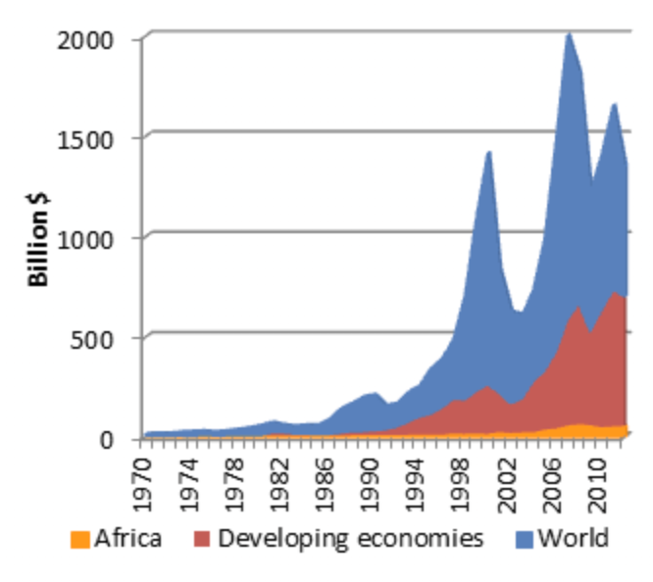
Puzzle #1: Underprovision of FDI into Africa?
Total FDI inflows, 1970-2010
Source
Many of the world’s fastest growing economies are located in sub-Saharan Africa.
So why does Africa still receive such a measly share of global FDI?

Slide 19
Group #1 notes

Slide 20
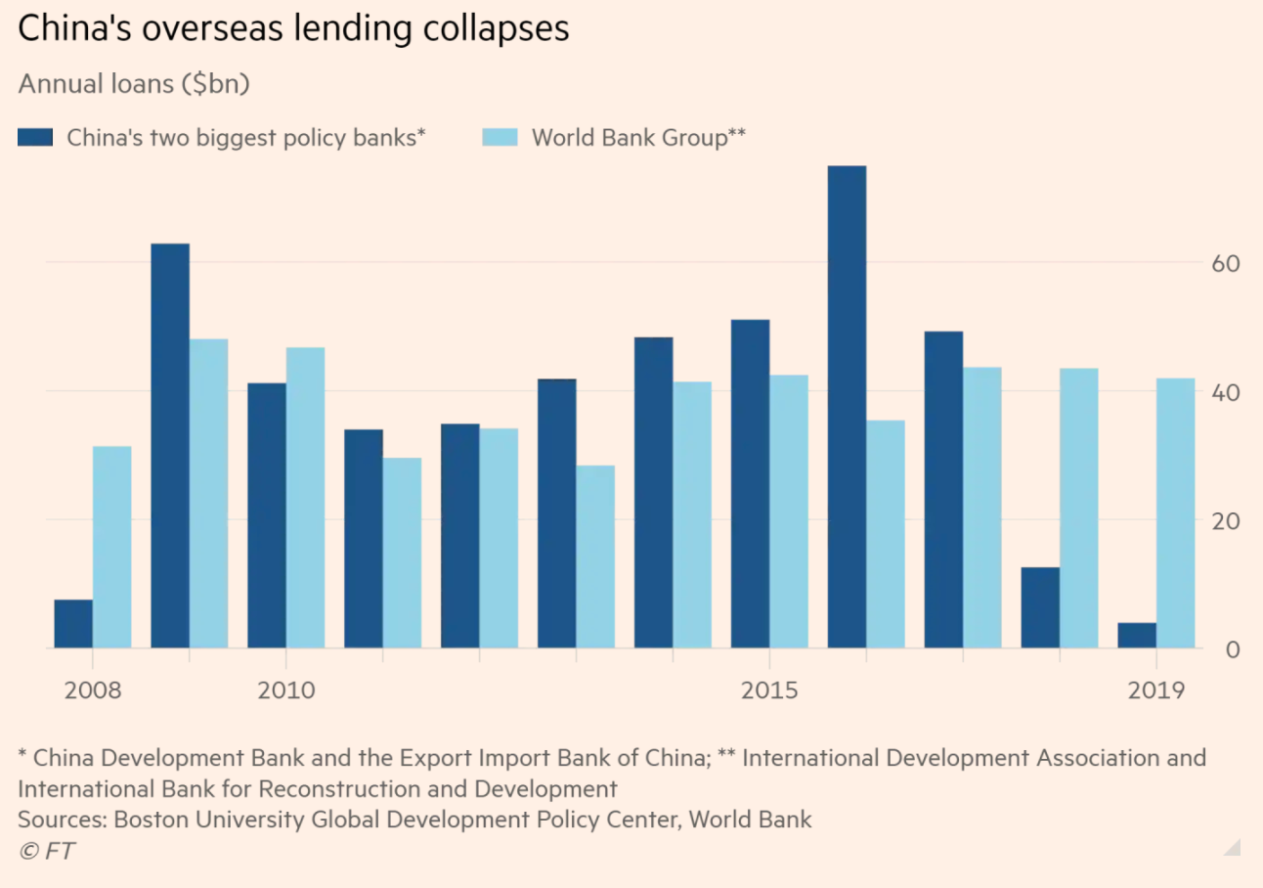
Puzzle 2: Is China’s Belt & Road Initiative an “Obsolescing Bargain”?
Why has China pulled back from its ambitious Belt and Road Initiative?
Does the “obsolescing bargain” help to explain this outcome?

Slide 21
Group #2 notes

Slide 22
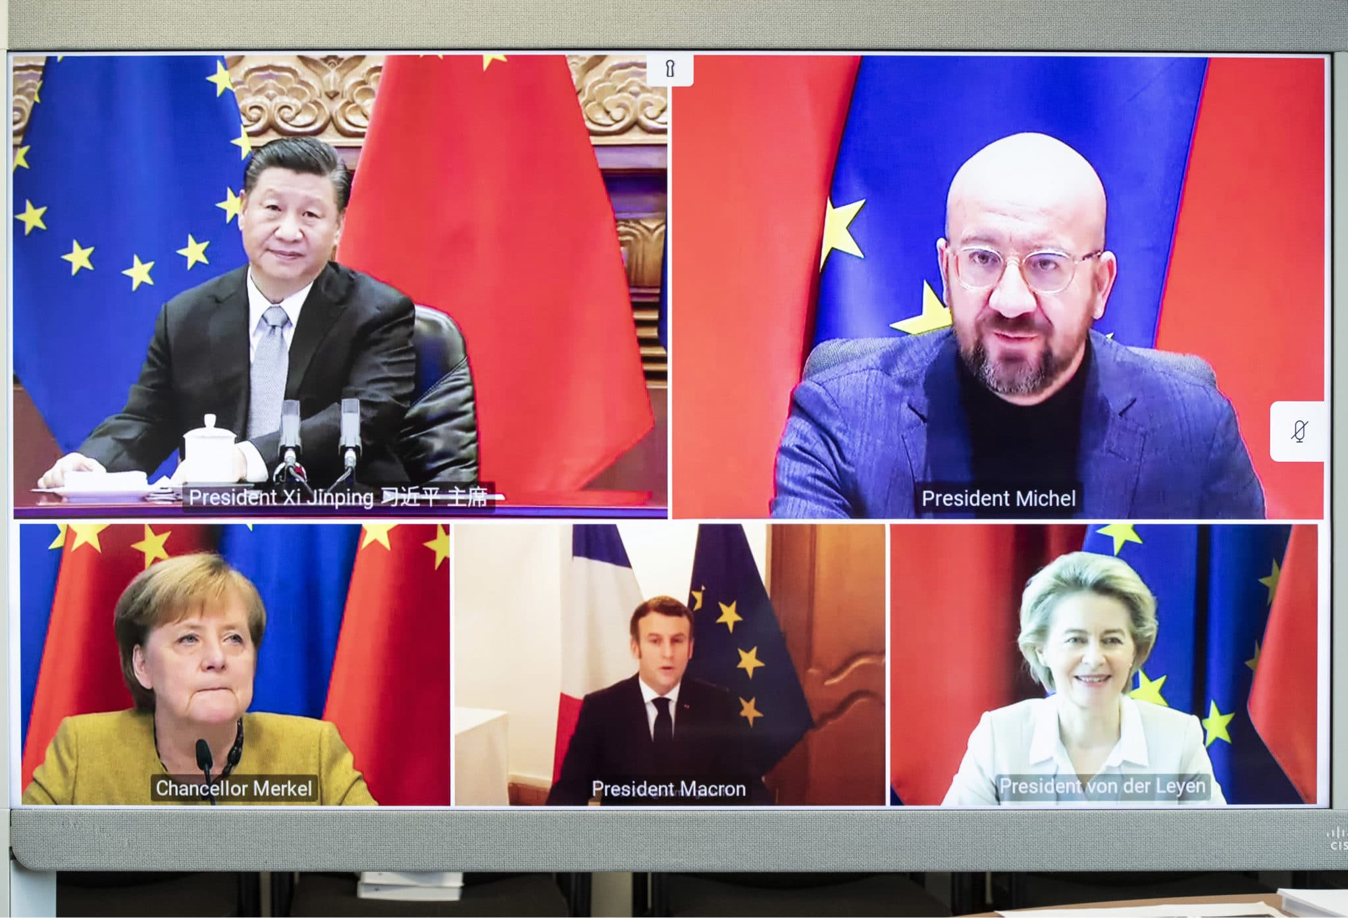
Puzzle #3: EU and China
The EU and China recently announced an investment agreement, while being embroiled in diplomatic conflict over human rights abuses by the Chinese regime.
How does looking at interests, interactions, and institutions help us to understand these divergent results?
The Comprehensive Agreement on Investment (aka, the first ever Zoom BIT?)

Slide 23
Group #3 notes

